Slide 1

Predicting the best neighborhoods for opening a new restaurant in Middelburg

Slide 2


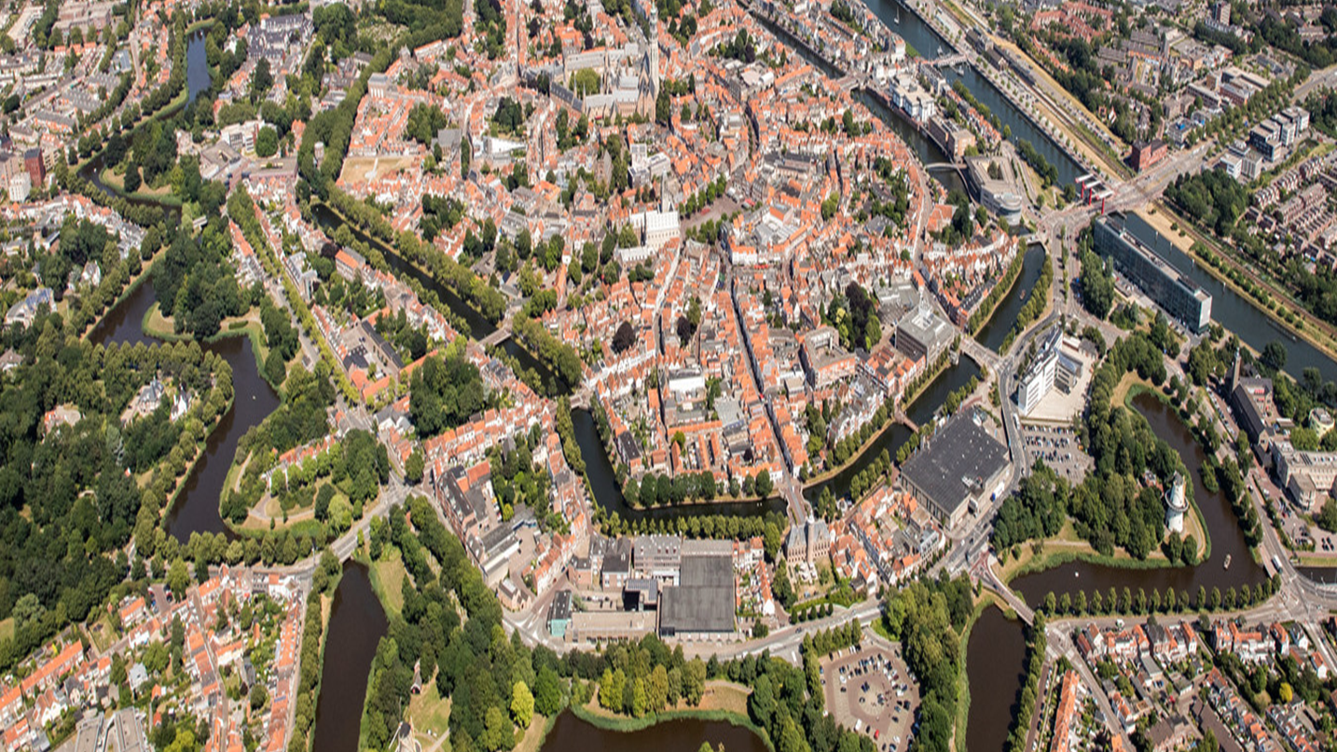




Slide 3
Predicting the best neighborhoods for opening a new restaurant in Middelburg
Collecting localizations all neighborhoods in Middelburg
Collecting the top 10 venues of each neighborhood
Using k-means clustering on venues data of each neighborhood
Combine or separate neighborhoods using k-means clustering
Comparing neighborhoods

Slide 4
Data acquisition
Dataset with coordinates of each neighborhood (11 neighborhoods)
Collected dataset with 76 unique venues in 11 neighborhoods and 183 items of raw data
Data frame with the top 10 venues of each neighborhood
Labeled data of each cluster with its combined neighborhood and it’s top 10 venues

Slide 5
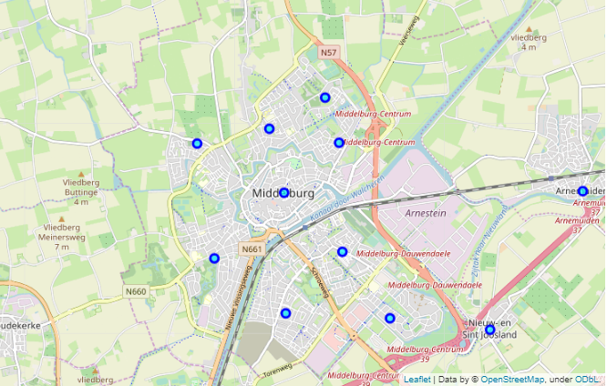
Neighborhoods with coordinates

Slide 6
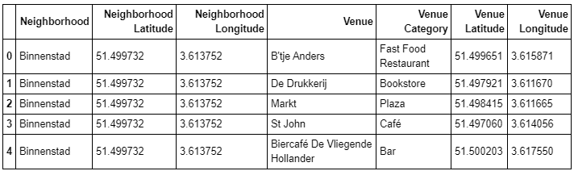
Collected dataset
* First five of the dataset

Slide 7
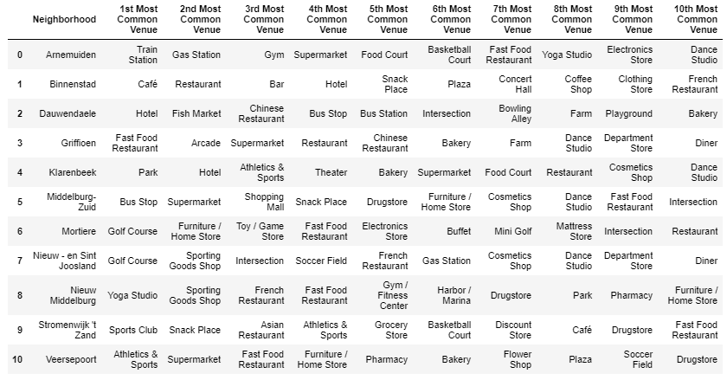
Dataframe with the top 10 venues for each neighborhood

Slide 8
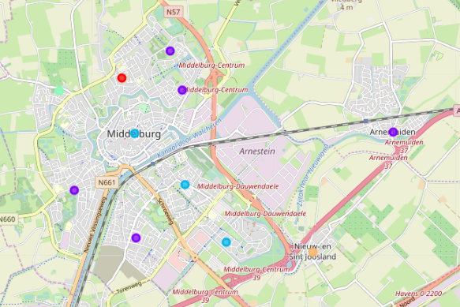
Visualizing Labeled clusters

Slide 9
Visualizing Labeled clusters

Slide 10
Conclusion and future directions
The answer is that cluster three is the best cluster
Accuracy of the k-means clustering model could be improved
Collect more data like the average income of residents in the neighborhood and the accessibility of public transport
Time to spend on the project could be improved by reducing the strict deadlines imposed by school so there’s more time to make the calculations and accuracy of the clustering model better

